Slide 1

JUSTME & Co.
™
.SHOP
A Shopify Alternative for the
African & Asian
Markets

Slide 2


WHAT
IS
SHOPIFY
?
Shopify is the best ecommerce platform that has everything you need to sell online.

Slide 3
ISSUES
TO BE
ADDRESSED
JUSTME & Co.

Slide 4
ORIGINAL REGIONAL TARGETS



US of AMERICA
CANADA
EUROPE

Slide 5


PAYMENT

METHODS

Slide 6






THIRD PARTY APPLICATIONS
OBERLO
PRINTFUL
TRACKTOR
PRINTIFY
*https://apps.shopify.com

Slide 7
OBJECTIVES
&
GOALS
JUSTME & Co.

Slide 8
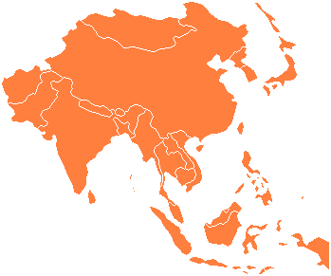
INITIAL “SPATIAL” TARGETS



NORTH AFRICA
SOUTH AFRICA
ASIA

Slide 9


END GOAL

Slide 10


“TEMPORAL” TARGETS
OCTOBER 2018
DECEMBER 2018

Slide 11




PAYMENT METHODS
CASH ON DELIVERY
2CHECKOUT
WeCHAT PAY
ALIPAY

Slide 12

THIRD PARTY APPLICATIONS
Illustration by Kim Rosen

Slide 13
LET’S
TALK
MONEY
JUSTME & Co.

Slide 14
THE WORKFORCE
/
/
/
7
8
3
2
DEVELOPERS
DESIGNERS
DB/SYS
ADMINS
NETWORK/CLOUD
ENGINEERS
/
/
/
6
4
5
1
CONTENT
EDITORS
LAWYERS
MARKETING
MANAGERS
PROJECT
MANAGER

Slide 15
ANNUAL COSTS
/
/
/
120k
65k
70k
75k
DEVELOPER
DESIGNER
DB/SYS
ADMIN
NETWORK/CLOUD
ENGINEER
/
/
/
30k
115k
125k
80k
CONTENT
EDITOR
LAWYER
MARKETING
MANAGER
PROJECT
MANAGER
*Avg. salaries 2015-2017
*https://www.glassdoor.com/salaries

Slide 16
ANNUAL COSTS
Roles | Employees | Yearly Salary | Total
Developers | 7 | 120k | 840k
Designers | 8 | 65k | 520k
DB/Sys Admin | 3 | 70k | 210k
Net/CC Engineers | 2 | 75k | 150k
Content Editors | 6 | 30k | 180k
Lawyers | 4 | 115k | 460k
Market. Managers | 5 | 125k | 625k
Project Managers | 1 | 80k | 80k
TOTALS | 36 |  | $ 3,065,000.00

Slide 17
BENEFITS PROJECTION
TOTAL COST
TOTAL BENEFITS

Slide 18
BUSINESS
RISKS
JUSTME & Co.

Slide 19

BEING SUPERMAN DOES’T CUT IT

Slide 20
RECOMMENDATION
JUSTME & Co.

Slide 21

DON’T
^

Slide 22


